Slide 1

  Landslides
  Lesson 2: Investigating Landslides

Slide 2

Investigating Landslides
Brainstorm
What factors affects landslides?
How might you investigate the factors that affect landslides?
Student Concept Sketch

Slide 3
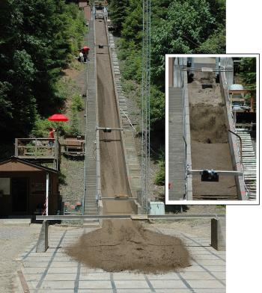
Debris Flow Flume
Engineers study how the following factors affect the area below a landslide:
Different materials
Steepness
Amount of water
SUSGS Debris-flow flume near Blue River, Oregon is used to conduct debris flows and landslide experiments. Flume is a reinforced concrete channel 95 m (310 ft long, 2 m (6.6 ft) wide, and 1.2 m (4 ft).

Slide 4

Debris Flow Flume Investigation
What are you investigating? Identify one factor (variable) that you want to investigate.
How will you conduct your investigation?
What data will you collect and how will you display it?

Slide 5
Debris Flow Flume Investigation
Data Table
Factor | Trial #1 | Trial #2
Make a claim about your data.
Use the data to support your claim.

Slide 6
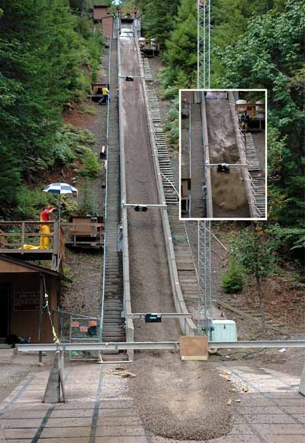
Comparing Results
The USGS conducted over 163 experiments using a debris-flow flume between the years of 1992 – 2017.
Compare your results with one of their experiments.
How was the USGS experiment similar to your experiment?
Did the USGS experiment support your claim with similar evidence?
https://pubs.usgs.gov/of/2007/1315/

Slide 7
Landslide Model
Revise your model with the following concepts:
Type of soil tested
Steepness of slope
Arrows showing direction of water
Student Concept Sketch

Slide 8

Positive Feedback
Walk around the class and take a tour of landslide models.
Identify at least 3 models without any sticky notes and leave a nice comment on a sticky note about the model.
“I like your model because …”

Slide 9
Guiding Question
How did the data you collected from your experiment help you think about the guiding question, “how can people prepare for the effects of the changing landscape on property?”

Slide 10
THANK YOU
Questions?

